Slide 1
Credit EDA Case Study
Hanumant Garad

Slide 2
Problem Statement
The loan providing companies find it hard to give loans to the people due to their insufficient or non-existent credit history. Because of that, some consumers use it to their advantage by becoming a defaulter. EDA to analyze the patterns present in the data. This will ensure that the applicants capable of repaying the loan are not rejected.
Business Objective
This case study aims to identify patterns which indicate if a client has difficulty paying their instalments which may be used for taking actions such as denying the loan, reducing the amount of loan, lending (to risky applicants) at a higher interest rate, etc. This will ensure that the consumers capable of repaying the loan are not rejected.

Slide 3
Steps performed….
Data Sourcing
Basic Data Understanding
Identify Missing and Outlier data points.
Missing value and Outlier Imputation.
Data Sanity checks
Data Imbalance check
Perform Univariate, Segmented Univariate and Bivariate Analysis
Data Merging
Univariate, Bivariate analysis on merged data.
Recommendations and Risks.

Slide 4
EDA on Application Data
Data Collection: Reading csv format data using python pandas library.
Data Understanding and Cleaning:
1. Missing Value Handling:
Removed Missing value columns where >= 40% of data points missing.
Removed unwanted / not relevant columns e.g., EXT_SOURCE_2/3.
Impute Missing values of Numerical variables using median as data is skewed.
Impute Missing values of categorical variables using mode or mark as different category where mode is not suitable method.
Impute Missing values of categorical variable from other observed related variable (MAR case).
New category created for categorical missing values where mode is not correct method to impute.
Derived New columns by adding up all values from different columns having same information split by hour, day, week, month and year.
2. Outlier Detection and Handling:
Outlier detected for numerical variables using Box-whiskers plots and capped to upper limit or median because of skewed distribution by looking distribution plots.
Outlier of ‘AMT_INCOME_TOTAL’ variable imputed independently per occupation type assuming income mostly related to occupation type.
3. Data Sanity Checks:
Data Type changed float to integer as nature of the values are discrete.
Data reformatting is done for few variables (conversion of negative values to positive values) e.g., all columns started with DAYS*

Slide 5
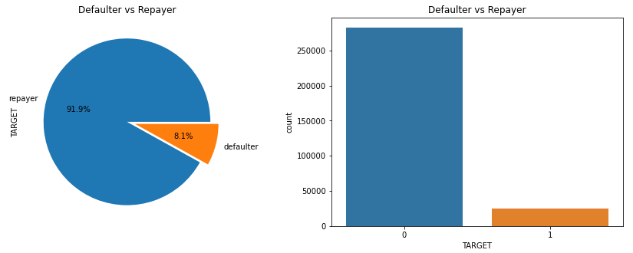
Data Imbalance:
It seems only 8.1 % applicants are having difficulties in repayment and imbalance ratio is 11.39 meaning every single defaulter there are ~11 non-defaulters.

Slide 6
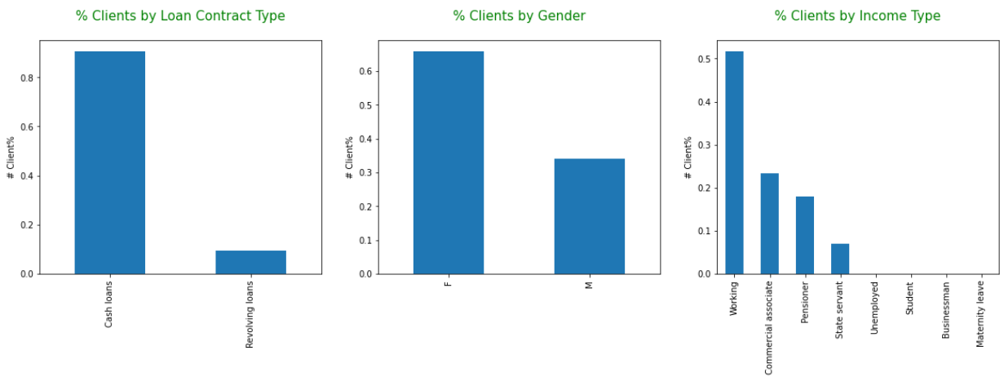
Univariate Analysis
Categorical Variables:
~85% clients goes for cash loan compared to revolving loan.
~65 of clients are female taken loan.
~50% of clients are working professionals taken loan.

Slide 7
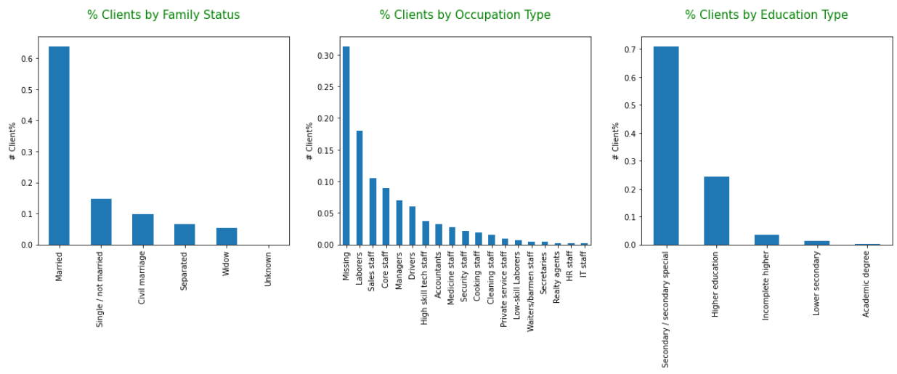
Univariate Analysis
Categorical Variables:
It is observed that Married clients are prone to the loans compare to widow and separated.
~30% of clients’ occupation is missing taken loan.
~70% of clients are secondary educated taken loan.

Slide 8
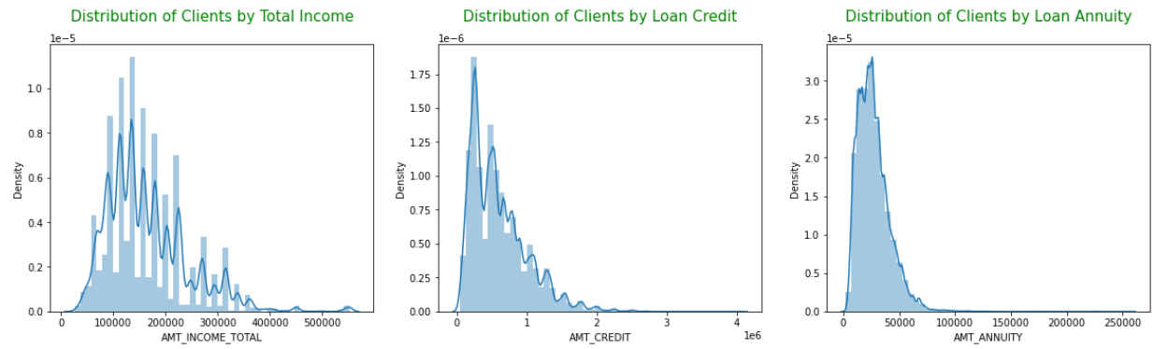
Univariate Analysis
Numerical Variables:
Clients with income ranging from 100k to 200k prone to loan.
Distribution in loan credit is normal except few extreme anomalies and loan credit is ranging from 1 millions to 1.5 millions.
Loan repayment installment amount is ranging from 20k to 50k.

Slide 9
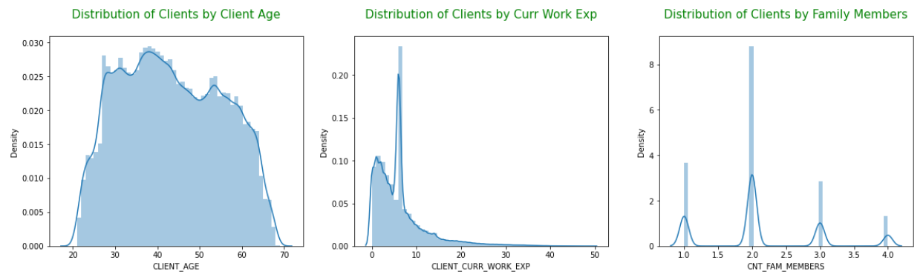
Univariate Analysis
Numerical Variables:
I can see client age is normally distributed however the age group 30 to 50 is highly tending towards loan.
Distribution of family members are kind of multimodal, majority of clients having 2 members in family.
Clients with 5-10 years of experience are taken loan in majority.

Slide 10
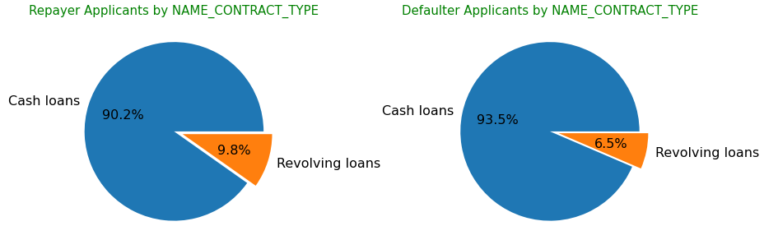
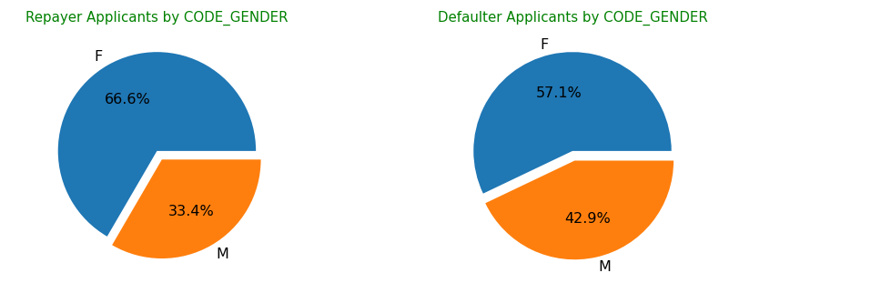
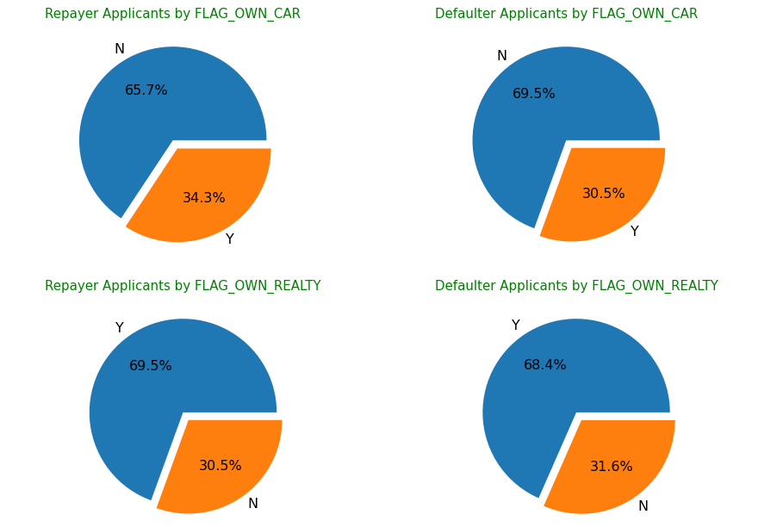
Segmented Univariate Analysis
Categorical Variables:
Defaulter applicants taken more cash loan compared to repayer applicants.
Female applied for loan higher than male and comparatively male defaulters are more compared to male repayers.
Who does not have car they are slightly more in defaulter group.
It seems there is no influence of property for getting loan.

Slide 11
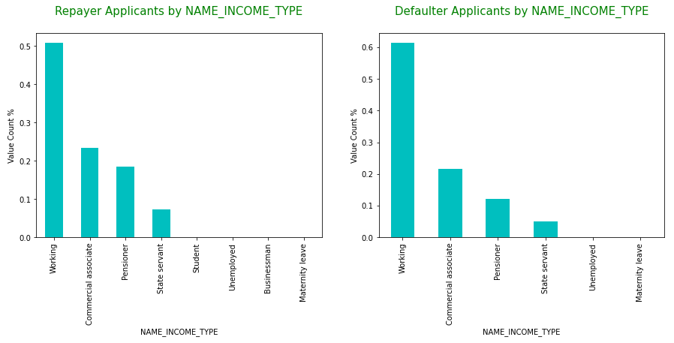
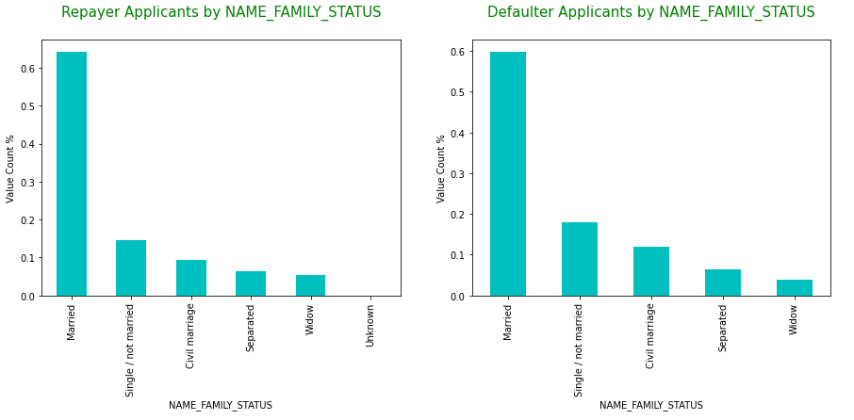
Segmented Univariate Analysis
Categorical Variables:
Clients from working professionals and commercial associates applied for loan almost 70% of the whole. Working professionals having high risk to default and businessman and state servants has less risk to default.
Those who are married applied for loan in majority (almost 60%) compared to others and very low % of widow applied for loan compared to others. Risk to default lies with Single / not married clients.

Slide 12
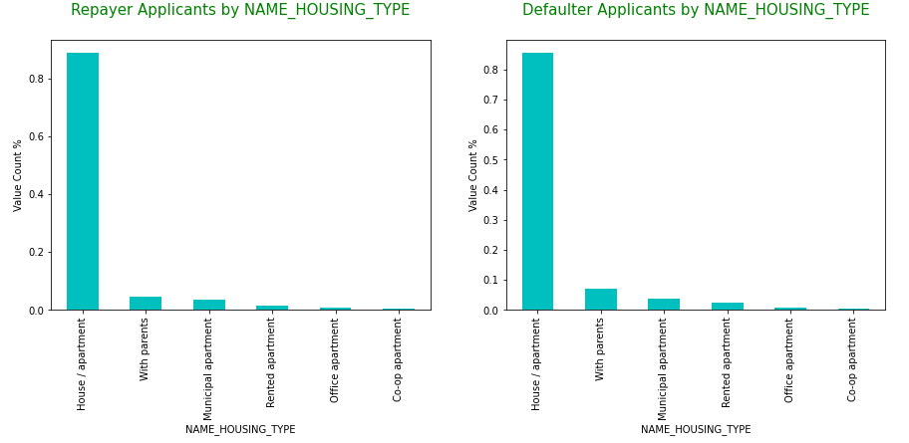
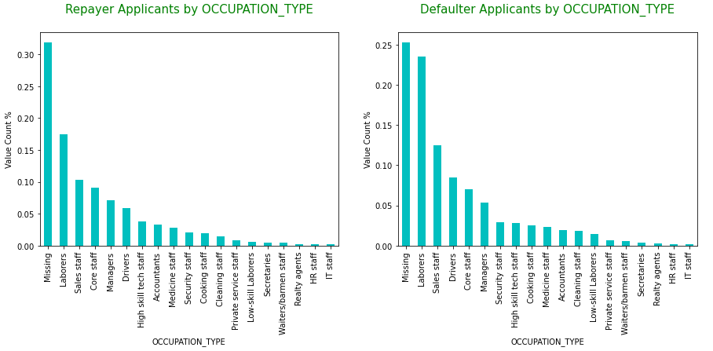
Segmented Univariate Analysis
Categorical Variables:
Clients living with parents and having own house / apartment applied for loan in majority compared to others. Clients living with parents are slightly risk to default.
Customers from occupation type Missing, Laboreres, Sales staff, Drivers, and Managers applied for loan in highest number compared to others in both target category. Leboreres, Sales staff and Drivers are high risk to default.

Slide 13
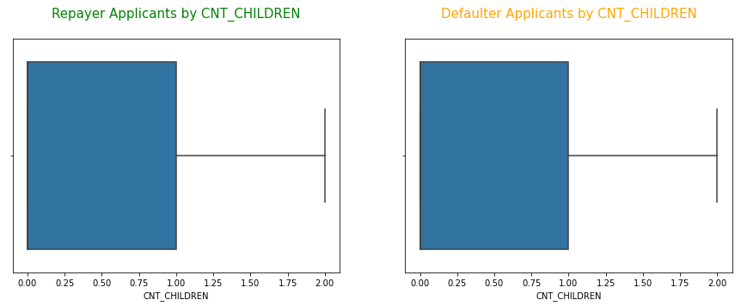
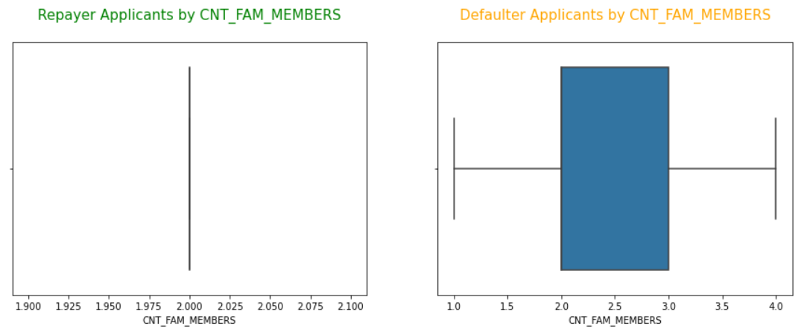
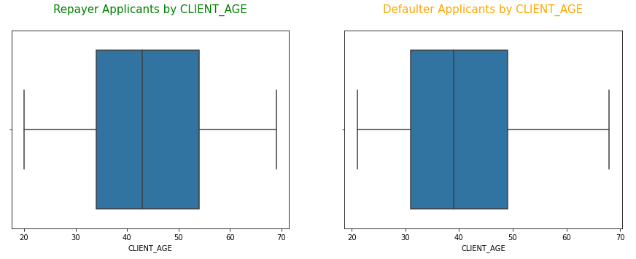
Segmented Univariate Analysis
Numerical Variables:
In both target category, majority of the clients have either 0 or 1 child.
Clients in defaulter category have 2-3 family members whereas repayer clients have 2 family members in majority. Clients with more family members could be risk to default.
50% of repayer clients are in 35-55 age group and defaulter clients are in 30-50 age group. It seems slightly younger clients are risk to default.

Slide 14
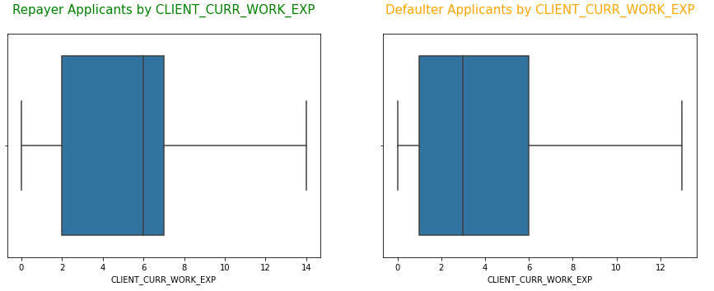
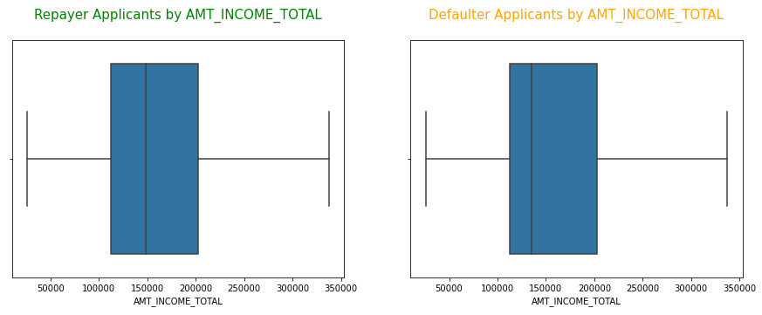
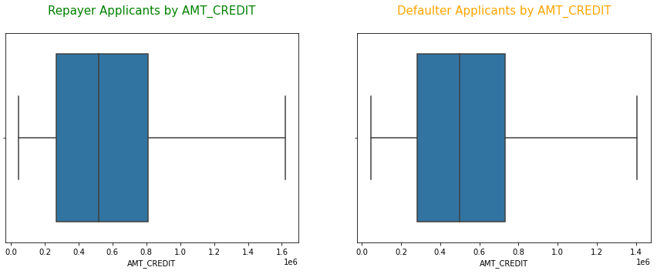
Segmented Univariate Analysis
Numerical Variables:
50% of repayer clients have 2-7 years of work experience and defaulter clients have 1-6 years of work experience. It slightly sense that lower experience clients are risk to default.
Median income of defaulters is slightly lower than repayers’ median income.
Amount of loan credit almost same in both target category.

Slide 15
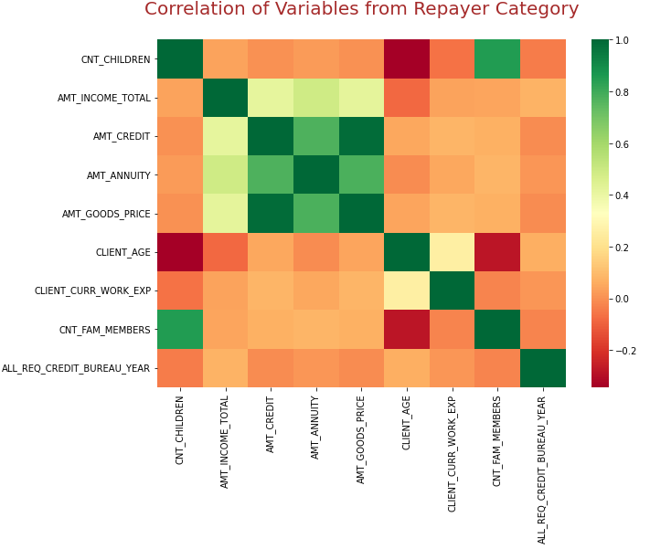
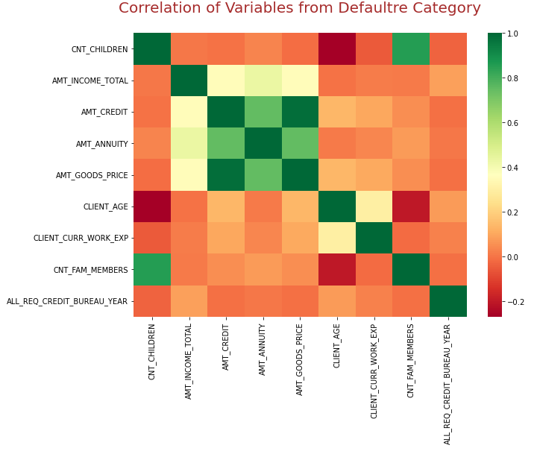
Segmented Bivariate Analysis
Numerical Variables vs Numerical Variables:
Loan Amount is strongly correlated with goods price for what loan applied.
Number of children is also showing relationship with count of family members.
Loan Installment amount is highly correlated with goods price for what loan applied and loan credit amount.

Slide 16
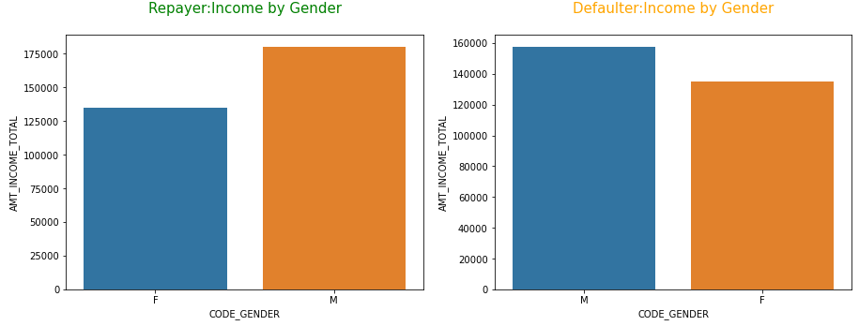
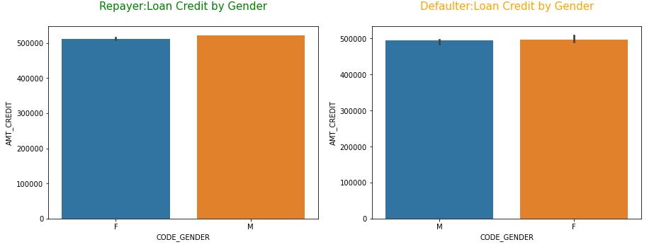
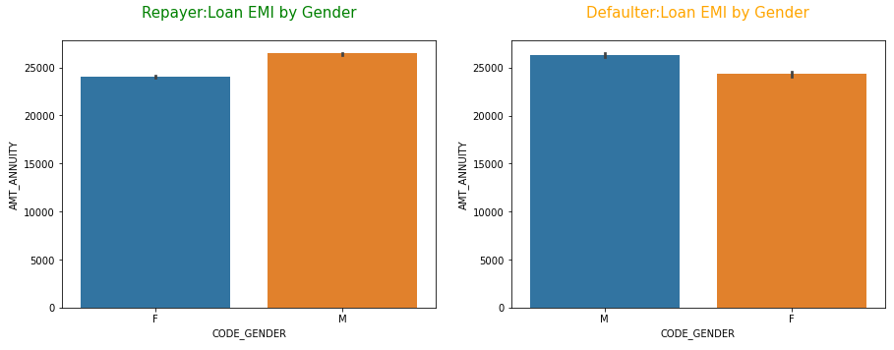
Segmented Bivariate Analysis
Numerical Variables vs Categorical Variables:
Total Income of male clients is more than female clients in both target category.
Proportion of the loan credit is almost equal for male and female in both target category though males’ total income is on high side.
Loan Installment amount for male is higher than female in both target category. May be female gets discount on loan interest rates.

Slide 17
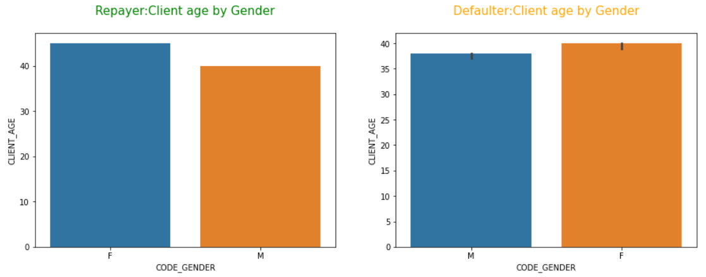
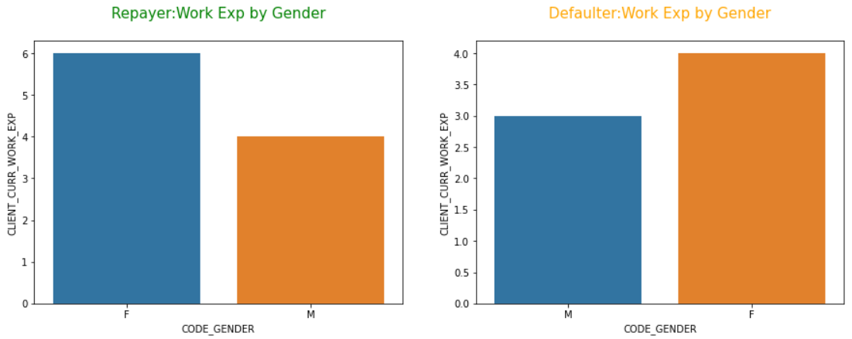
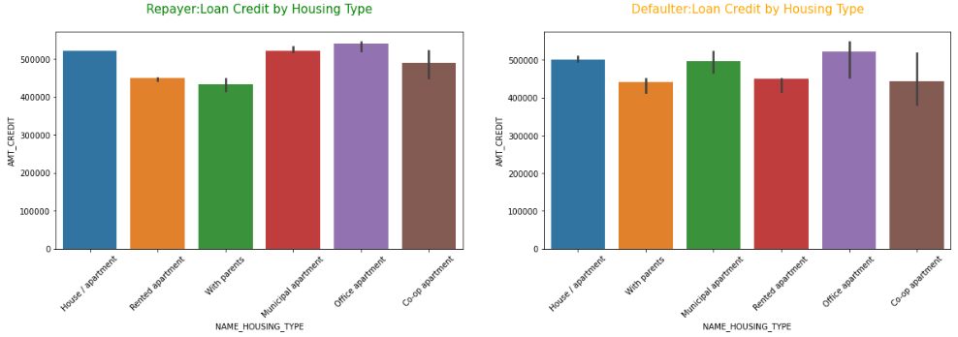
Segmented Bivariate Analysis
Numerical Variables vs Categorical Variables:
Male clients are younger than female clients in both target category.
Male clients are younger in work experience compared to female clients in both target category.
Clients who lives in office apartment and own house eligible for loan credits. Clients lives with parents are less likely to get high loan credit.

Slide 18
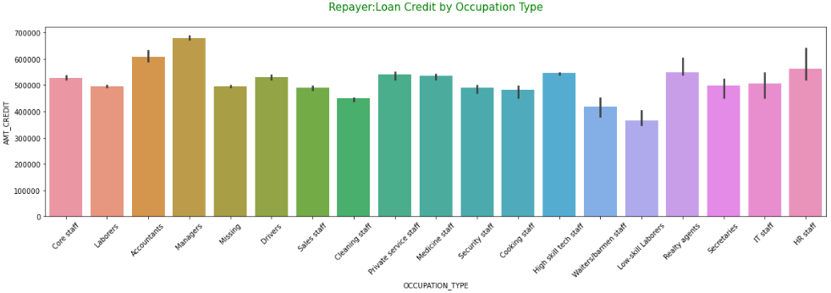
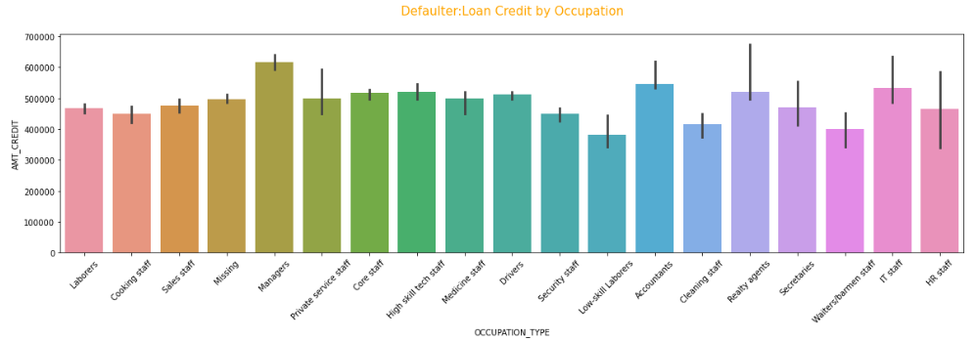
Segmented Bivariate Analysis
Numerical Variables vs Categorical Variables:
Clients with accountant and manager role are eligible for more loan credit compared to low skilled laboreres and waiters in both target category

Slide 19
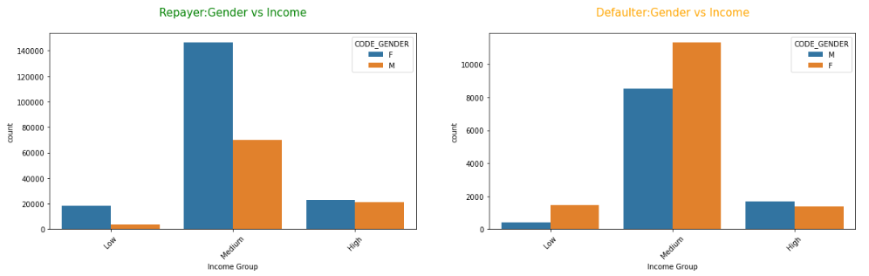
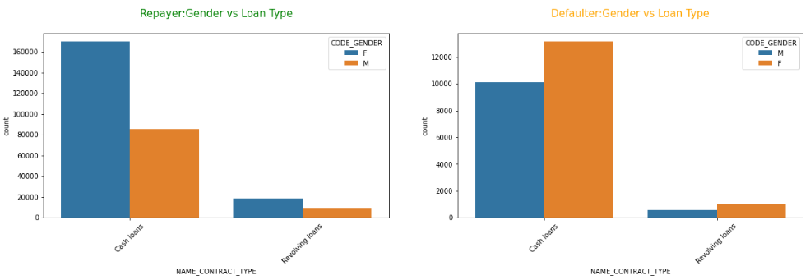
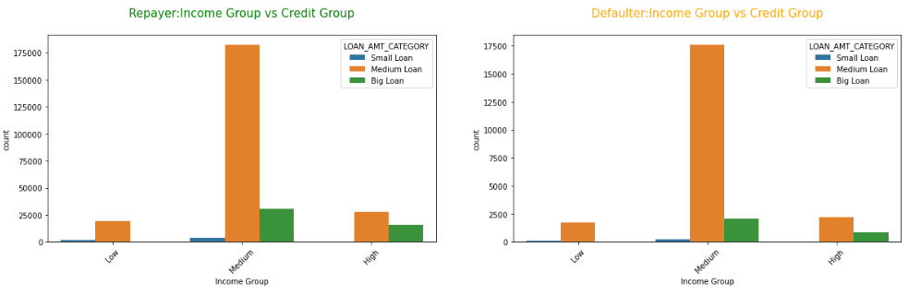
Segmented Bivariate Analysis
Categorical Variables vs Categorical Variables:
All income group count of female clients is more compared to male clients in both category.
Cash loan and revolving loan given to more female clients in both target category.
It clearly seen that big loan is not given to low-income group clients and Count of medium range loan is high in medium income group only in both target category.

Slide 20
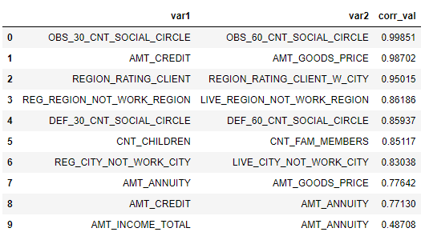
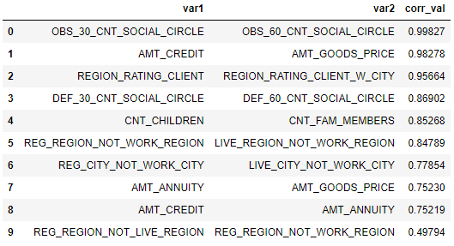
Top 10 Correlation Matrix
Correlation Matrix from repayer data frame
Correlation Matrix from defaulter data frame

Slide 21
EDA on Previous Application Data
Data Collection: Reading csv format data using python pandas library.
Data Understanding and Cleaning:
1. Missing Value Handling:
Removed Missing value columns where >= 40% of data points missing.
Impute Missing values of Numerical variables using median as data is skewed
Impute Missing values of categorical variables using mode.
New category created for categorical missing values where mode is not correct method to impute.
2. Outlier Detection and Handling:
Outlier detected using Box-whiskers plots and capped to upper limit or median because of skewed distribution by looking distribution plots for numerical variables.
Outlier detected by listing unique values from categorical variables and imputed either using mode or by creating new category.

Slide 22
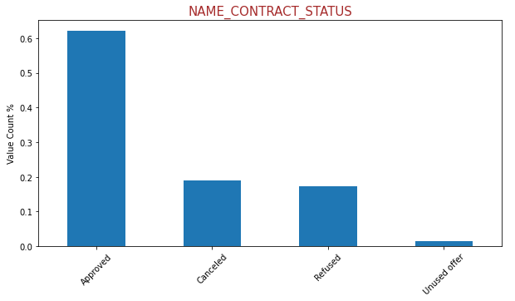
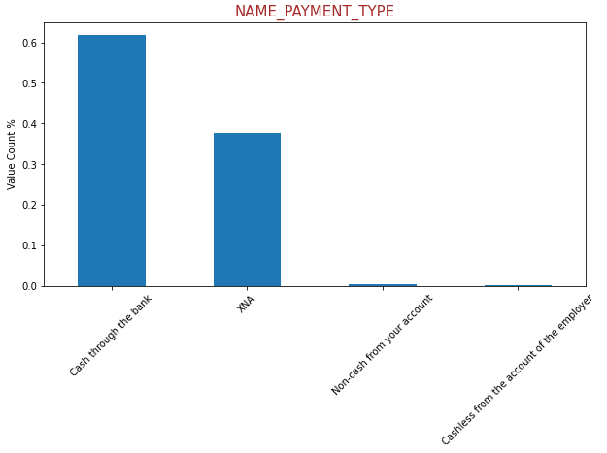
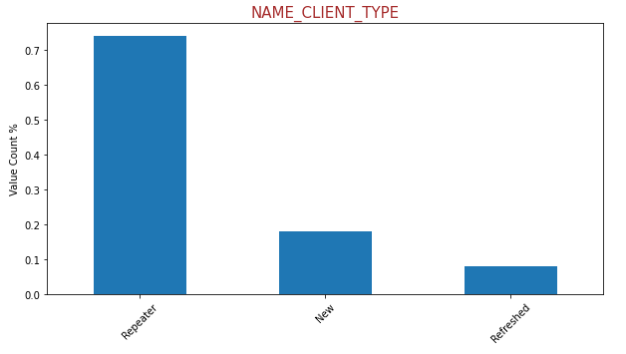
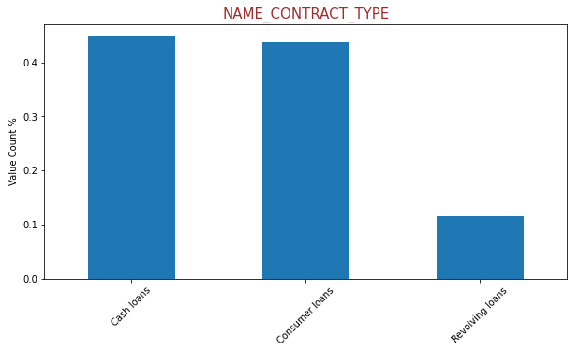
Univariate Analysis
Categorical Variables:
almost 60% of applicants got approval for the loan. nearly 19% of applicants cancelled the loan application and nearly 18% of applicants loan rejected.
~70% of applicants are old clients and ~18% of clients are new.
~60 % of applicants choose cash through the bank repayment methods, and less than 1% applicants choose cash less payment method and that may lead to default. Here XNA (around 38%) is may be because of applicants who either canceled their application or their application got rejected.

Slide 23
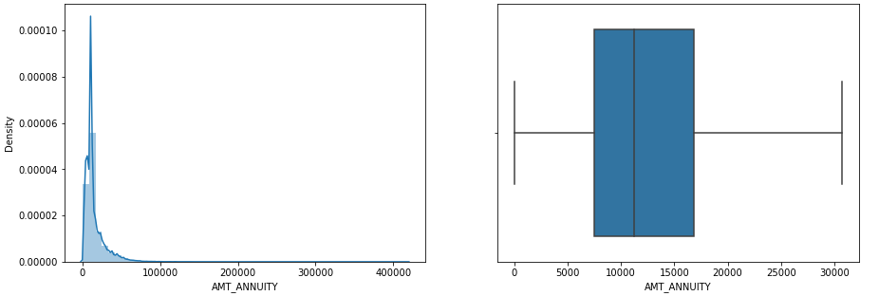
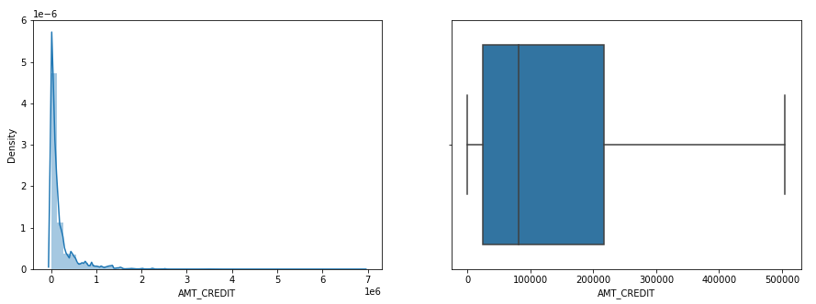
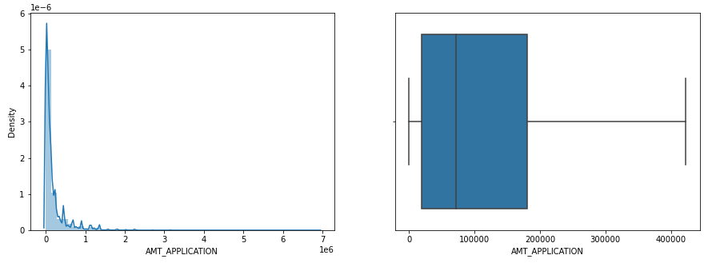
Univariate Analysis
Numerical Variables:
Histogram of all variables show skewed distribution due to extreme outliers in very low frequency, so outliers are excluded from box plot to get clear insights.
50% of clients pay loan installment amount ranging from ~7k to ~18k.
50% of clients are having loan credit ranging from ~40k to ~2millions.
Loan application amount is almost complementing with loan credit amount though surprisingly loan credit amount is slightly higher than loan application amount

Slide 24
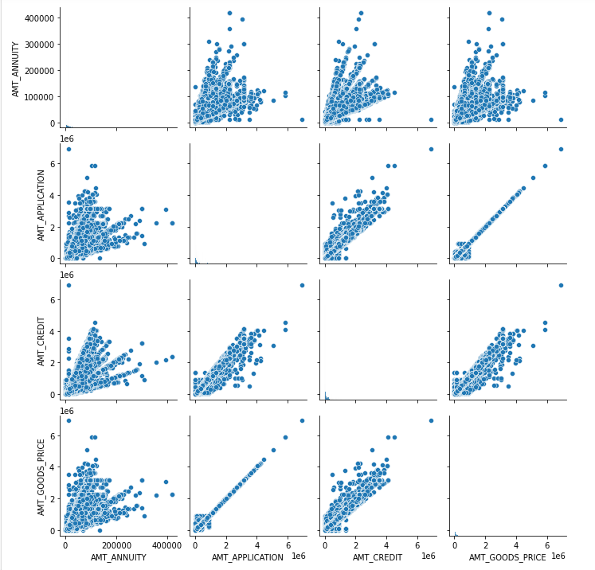
Bivariate Analysis
Numerical Variables vs Numerical Variables:
Loan application amount has strong correlation with amount of goods for what loan applied and it makes sense.
Loan credit amount has good correlation with amount of goods for what loan applied and loan application amount.
Loan Installment amount is also showing correlation with loan application amount, loan credit and goods price.

Slide 25
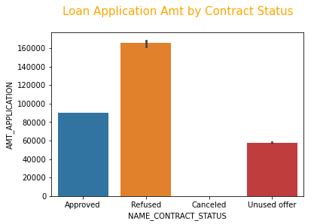
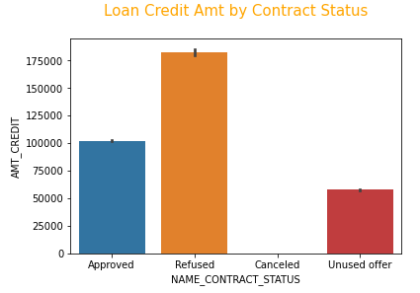
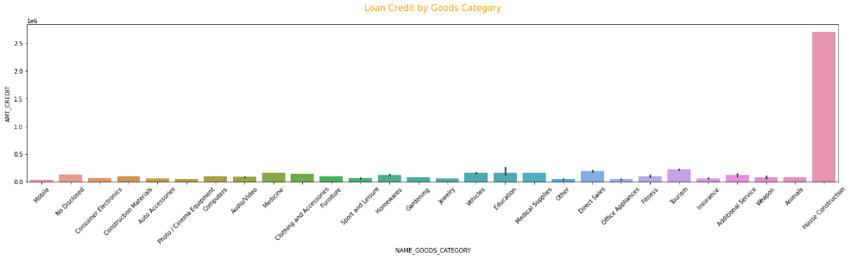
Bivariate Analysis
Numerical Variables vs Categorical Variables:
It seems that higher loan application amount get rejection in loan application.
How can clients have got refusal if final loan credit amount populated.
From loan credit by goods category bar charts clearly shows house construction grabs highest loan credit compared to all other goods.

Slide 26
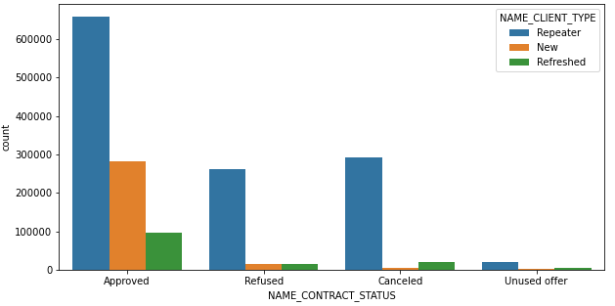
Bivariate Analysis
Categorical Variables vs Categorical Variables:
The clustered bar charts show that repeater are getting higher chance to loan approval

Slide 27
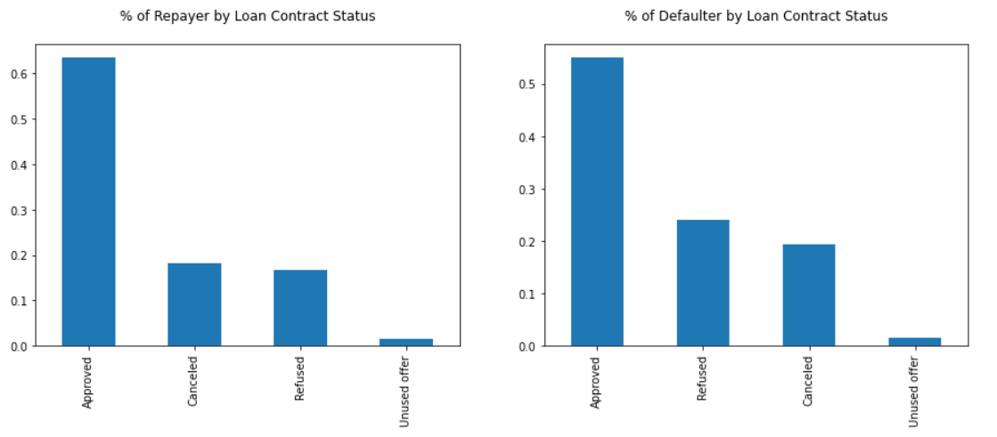
Univariate Analysis on Merged Data frame
% of defaulters are high for previously refused applicants comparatively to others

Slide 28
Recommendations and Risks
Recommendations:
Female clients in general
Clients with less family members
Clients with more work experience
Clients with high income group
Clients who are state servants
Clients whose previous loan is approved.
Risks:
Clients who are Laborers, Sales staff and Drivers
Secondary educated clients
Clients who are single and not married
Younger male clients whose loan installment is high and has low work experience.
Clients who does not own car
Clients living with parents

Slide 29

Thank you

